Slide 1
Logic
Gates
BY:-
Ranak Samal
2110544

Slide 2
Context:-
AND gate
OR gate
NOT gate
NAND gate
NOR gate
EX-OR gate
EX-NOR gate

Slide 3
Logic gates and their IC Specification
Sl No. | Name of the logic gates | Specification
1 | AND | IC-7408
2 | OR | IC-7432
3 | NOT | IC-7404
4 | NAND | IC-7400
5 | NOR | IC-7402
6 | EX-OR | IC-7486
7 | EX-NOR | IC-4077

Slide 4
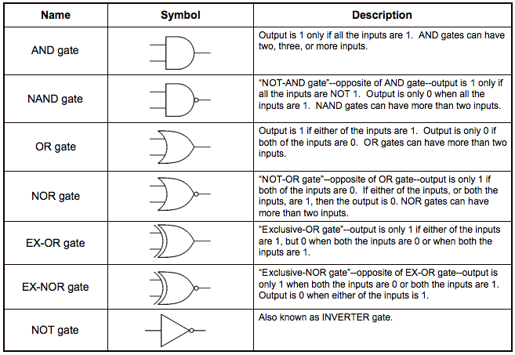
Brief Descriptions

Slide 5
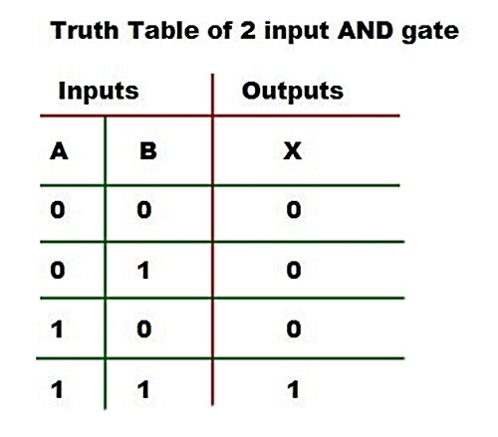
AND gate:-
It performs the logic Multiplication.
The output will be high(1), if all the inputs are high(1), otherwise low(0).
A
AND
C=A.B
B

Slide 6
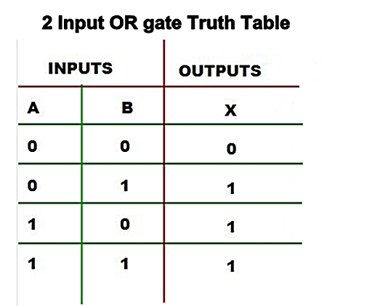
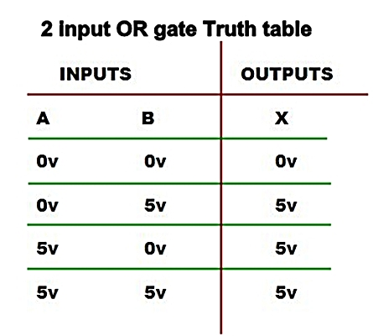
OR gate:-
It performs the logic addition known as OR function.
The output will be high(1), if any of the input is high(1), otherwise low(0).
A
OR
C=A+B
B

Slide 7
NOT gate:-
It performs a basic logic function called inversion or complementation.
The output will be high(1) if the input is low(0) and the output will be low(0) if the input is high(1).
NOT

Slide 8
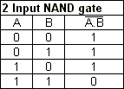
NAND gate:-
The term NAND is a contraction of NOT+AND.
It implies AND function with complemented output.
The output will be low(0), The output will be high(1), if all the inputs are high(1), otherwise low(0). if all the inputs are high(1), otherwise high(1).
A
NAND
C=A.B
B

Slide 9
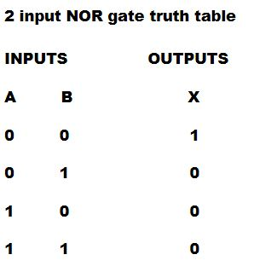
NOR gate:-
The term NOR is a contraction of NOT+OR.
It implies OR function with complemented output.
The output will be low(0), if any of the input is high(1), otherwise high(1).
A
NOR
C=A+B
B

Slide 10
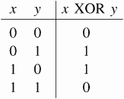
EX-OR gate:-
The output will be high(1), When the input are different, otherwise low(0).
A
EX-OR
C=A + B
B

Slide 11
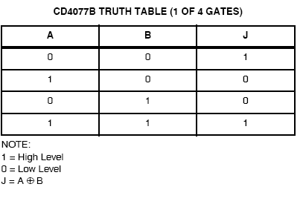
EX-NOR gate:-
The term EX-NOR is a contraction of NOT+EX-OR.
The output will be low(0), When the input are different, otherwise high(1).
A
EX-NOR
C=A + B
B

Slide 12
THANK YOU

